Slide 1
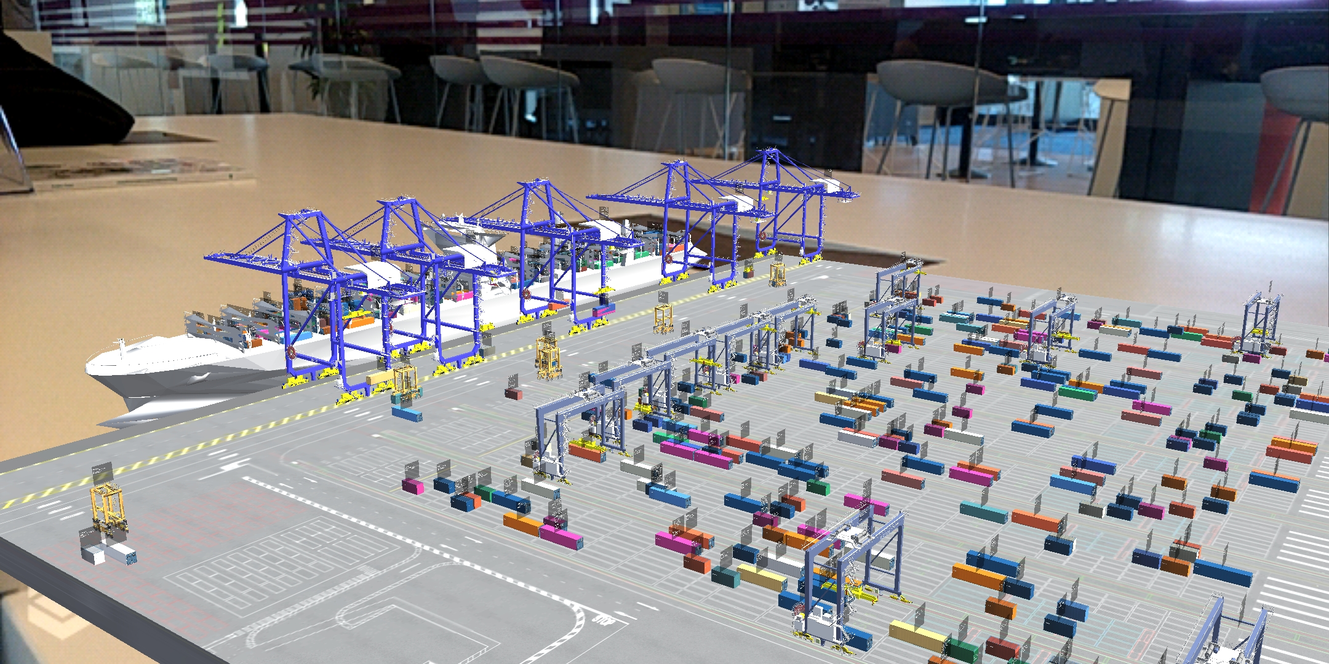





HARBOR VR SIMULATION
AR/VR
In a collaboration between CoLab and the Transport and Logistics unit, we developed a virtual reality simulation of a harbor. The project consists of two sides.
A server side simulation engine that sends the movement and the position of every object,
A front-end application that provides the user with a bird-view of the whole operation in the harbor.
The project is to be presented in TOC Europe in Rotterdam Ahoy. ICT Group is part of this event with the Transport & Logistics unit.
The front-end application has three version for the following platforms:
A PC version where the user can walk around the harbor terminal, view the operation of each 3D model from different camera angles and see details for each container.
VR Android app. The user scans a marker image where the harbor terminal is desired to be placed. Viewing the harbor by moving around as the image above.
VR Magic Leap application. A headset version that offers surrounding view of the harbor with controls using the magic leap controller.

